Slide 1

SEASONAL AGRICULTURE
PERFORMANCE ANALYSIS
Sneha N H
Kalpataru Institute of Technology, Tiptur
AICTE STU ID : STU6a056952c63f41778739538

Slide 2

PROBLEM STATEMENT
• Agricultural performance is influenced by seasonal environmental conditions, farming practices, resource availability and market conditions.
• Raw agricultural data does not clearly explain how performance changes across seasons or what patterns occur under different seasonal conditions.
• The project therefore analyzes the agricultural dataset to identify meaningful seasonal patterns, trends, relationships and variations.

Slide 3
PROJECT DESCRIPTION
• A focused data analytics study of agricultural activities across different seasons and farming conditions.
• The workflow includes dataset loading, inspection, data cleaning, column identification, grouped analysis and visualization.
• The analysis examines seasonal yield and profit patterns and prepares crop-by-season comparisons.
• The project uses Python-based analytics to interpret agricultural performance from the available evidence.
PRIMARY OBJECTIVE
Identify meaningful patterns, trends, relationships and differences in agricultural performance across seasons.

Slide 4

WHO ARE THE END USERS?
• Farmers and farm managers — understand seasonal performance patterns.
• Agricultural planners and stakeholders — support evidence-based seasonal planning.
• Researchers and analysts — compare crops, seasons and observed agricultural trends.
• Students and project teams — use the workflow as a focused real-world data analytics study.

Slide 5

TECHNOLOGY USED
• Python — core programming and analysis
• Pandas — data loading, cleaning and aggregation
• NumPy — numerical operations
• Matplotlib — charts and visualization
• Seaborn — visualization styling
• SciPy — Pearson correlation/statistical analysis
• OpenPyXL — Excel file handling
• Google Colab / Jupyter Notebook — analysis environment

Slide 6
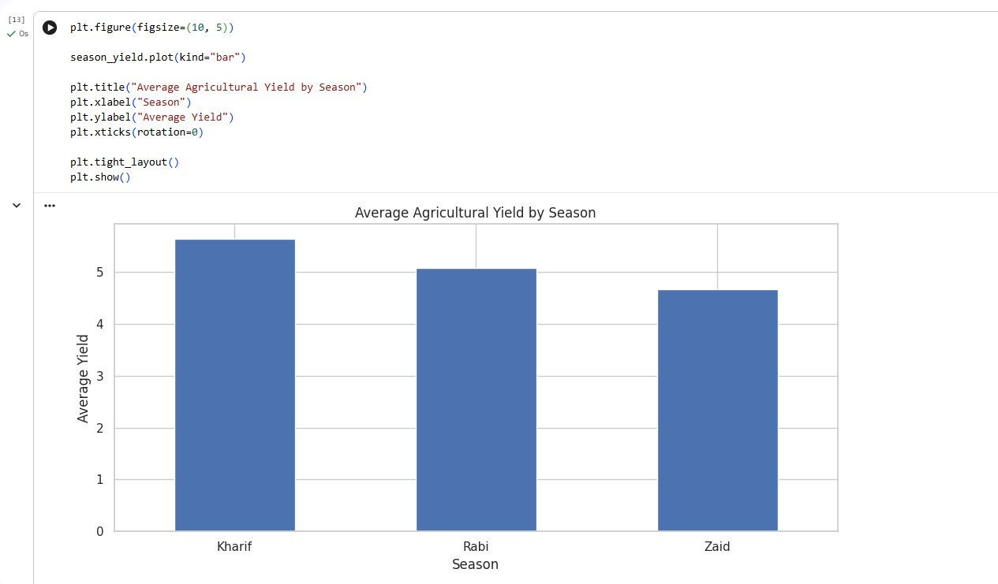
RESULTS
Seasonal Yield Comparison
Analysis Coverage
• Average yield is compared for Kharif, Rabi and Zaid.
• Kharif shows the highest average yield in the provided visualization.
• Rabi follows Kharif, while Zaid is the lowest among the three seasons.
• Dataset inspection and quality checks
• Duplicate and empty-row removal
• Automatic identification of relevant columns
• Crop-by-season average yield analysis
• Season-wise profit analysis setup
Average Agricultural Yield by Season

Slide 7
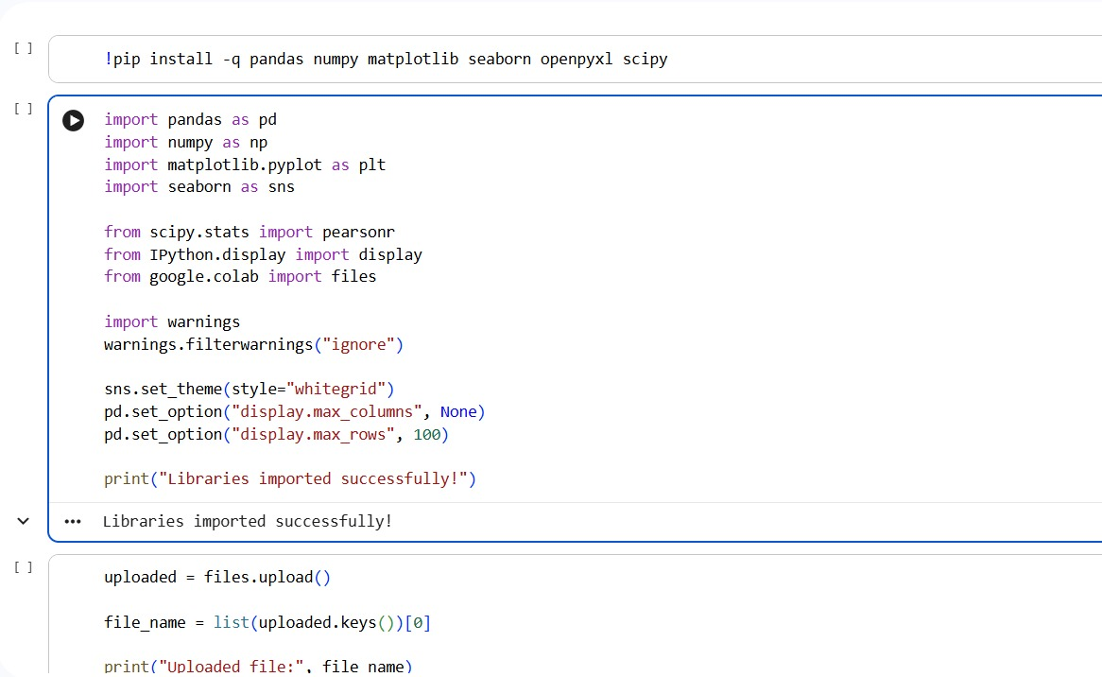
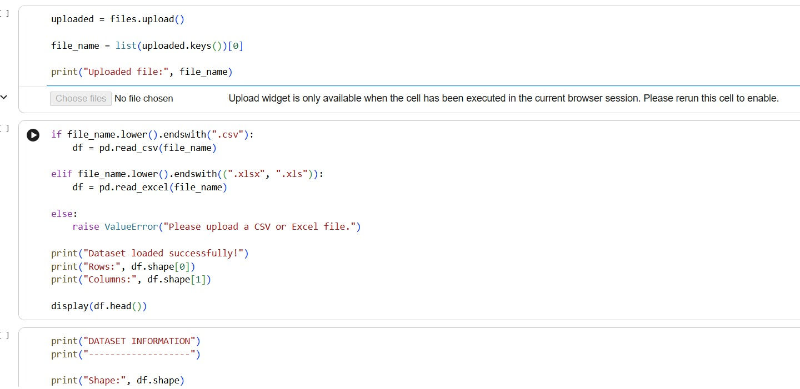
RESULTS
1. Library setup and analysis environment
2. Dataset upload and loading
CSV/Excel upload and dataset loading
Python libraries and visualization/statistical setup

Slide 8
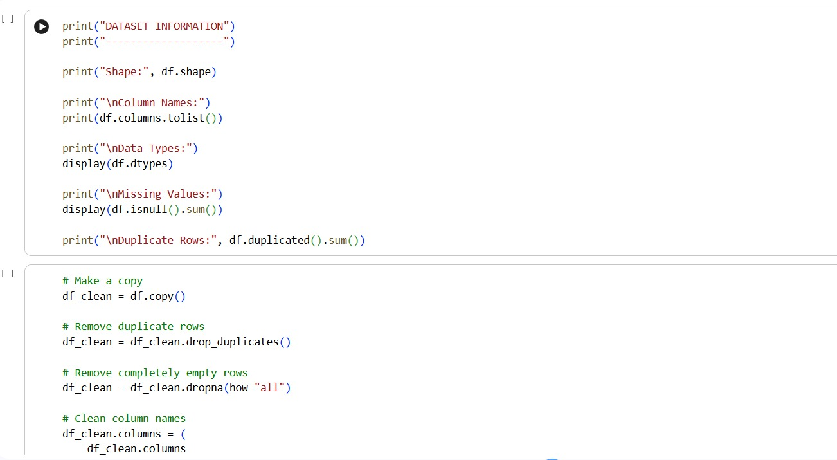
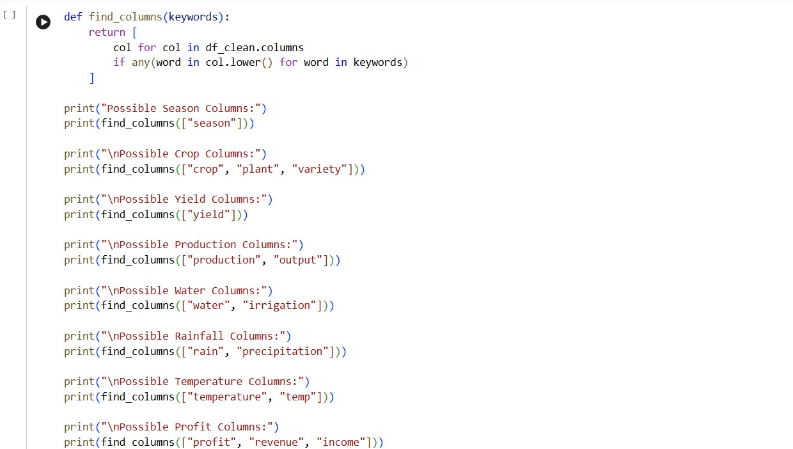
RESULTS
3. Dataset information and cleaning workflow
4. Column discovery for seasonal analysis
Shape, columns, data types, missing values and duplicates
Season, crop, yield, production, water, rainfall, temperature and profit columns

Slide 9
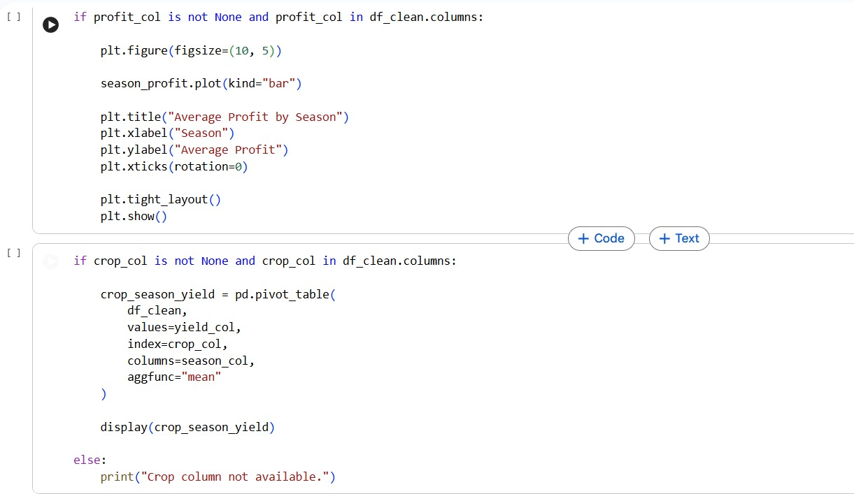
RESULTS
5. Crop-by-season yield pivot and season-wise profit analysis
Pivot-table based crop × season yield analysis and season-profit plotting logic

Slide 10
RESULTS
Key findings from the analysis
• Season-wise average yield was successfully visualized for Kharif, Rabi and Zaid.
• The provided chart indicates Kharif as the highest-yielding season, followed by Rabi and Zaid.
• The workflow removes duplicate rows and completely empty rows before analysis.
• Relevant columns are identified using keyword-based matching for season, crop, yield, production, water, rainfall, temperature and profit-related fields.
• The analysis is structured to support evidence-based interpretation rather than generic exploration of the entire dataset.
Seasonal yield result

Slide 11
FUTURE SCOPE
• Extend comparisons across regions and crop categories to identify consistent seasonal patterns.
• Integrate richer environmental and resource variables for deeper seasonal analysis.
• Apply statistical and predictive techniques to investigate relationships and support forecasting.
• Build interactive dashboards for easier communication of seasonal agricultural insights.
• Use the findings to support improved seasonal agricultural planning and further investigation.

Slide 12
GITHUB LINK
https://github.com/snehanhhiregoudra-dotcom/Seasonal-Agriculture-Performance-Analysis
Seasonal Agricultural Performance Analysis project repository
Repository contains the project analysis and supporting work.

Slide 13

VOIS COURSE COMPLETION CERTIFICATE
Course: Data Visualization

Slide 14
Thank you
Sneha N H
Kalpataru Institute of Technology, Tiptur
Seasonal Agriculture Performance Analysis

